Slide 1
INTRODUCTION TO CONTROL SYSTEM CODE: COB 3134 UQF 7 - B
Prepared by: Vicent V.M., MSc.
Nov., 2021

Slide 2
Learning Context
Control system definitions; principles of feedback control system; control system block diagrams model; control flow diagram model; mathematical modelling of control system; sensitivity, transient response; stability criteria; steady state error; root locus methods; transfer functions
So as to have the:
Ability to define the control system
Ability to draw signal flow block diagram
Ability to describe a control system
Explain basic principles of control system
Calculate stability parameters
Derive mathematical model of the control system
Ability to derive a transfer function of the control system

Slide 3
Introduction to Control System Engineering
Engineering is concerned with understanding and controlling the materials and forces of nature for the benefit of humankind.
Control system engineers are concerned with understanding and controlling segments of their environment, often called systems, to provide useful economic products for society. The twin goals of understanding and controlling are complementary because effective systems control requires that the systems be understood and modelled.
Therefore:
A control system is an interconnection of components forming a system configuration that will provide a desired system response

Slide 4
Open – loop control System (without feedback)
The basis for analysis of a system is the foundation provided by linear system theory, which assumes a cause–effect relationship for the components of a system.
Therefore a component or process to be controlled can be represented by a block, as shown in figure 1.1. The input–output relationship represents the cause-and-effect relationship of the process, which in turn represents a processing of the input signal to provide an output signal variable, often with a power amplification. An open-loop control system utilizes a controller or control actuator to obtain the desired response, as shown in figure 1.2. An open-loop system is a system without feedback.
Process -

Slide 5
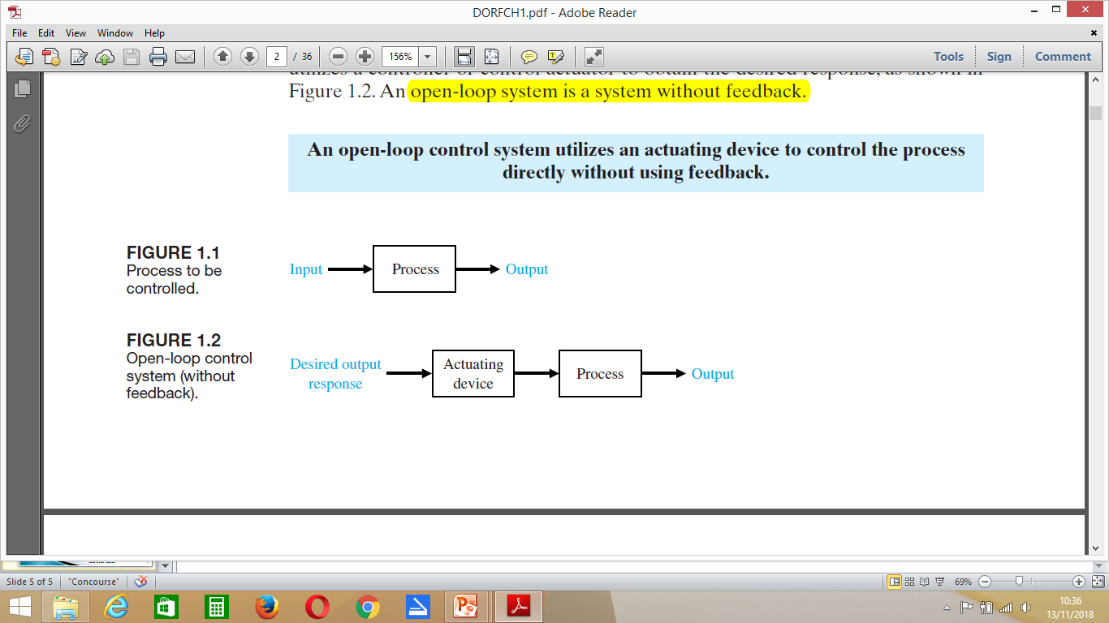
Cont..
Fig. 1.1: Process to be controlled
Fig. 1.2: Open - loop control system
Therefore:
An open – loop control system utilizes an actuating device to control the process directly without using feedback

Slide 6
Cont..
Advantages of Open-Loop Control System
The followings are the advantages of an open-loop control system:
These systems are simple in construction and design.
These systems are economical.
These systems are easy from maintenance point of view.
Usually these systems are not much troubled with problems of stability.
These systems are convenient to use when output is difficult to measure

Slide 7
Cont..
Disadvantages of Open-Loop Control System
The followings are the disadvantages of an open-loop control system:
These systems are not accurate and reliable because their accuracy dependent on the accuracy of calibration.
In these systems, inaccuracy results are obtained with parameter variations i . e . internal disturbances.
Recalibration of the controller is required from time to time for maintaining quality and accuracy
Any change in output cannot be corrected automatically

Slide 8
Closed-Loop Control System (with feedback)
In contrast to an open-loop control system, a closed-loop control system utilizes an additional measure of the actual output to compare the actual output with the desired output response. The measure of the output is called the feedback signal. A simple closed-loop feedback control system is shown in figure 1.3. A feedback con- trol system is a control system that tends to maintain a prescribed relationship of one system variable to another by comparing functions of these variables and using the difference as a means of control.
A feedback control system often uses a function of a prescribed relationship between the output and reference input to control the process.

Slide 9
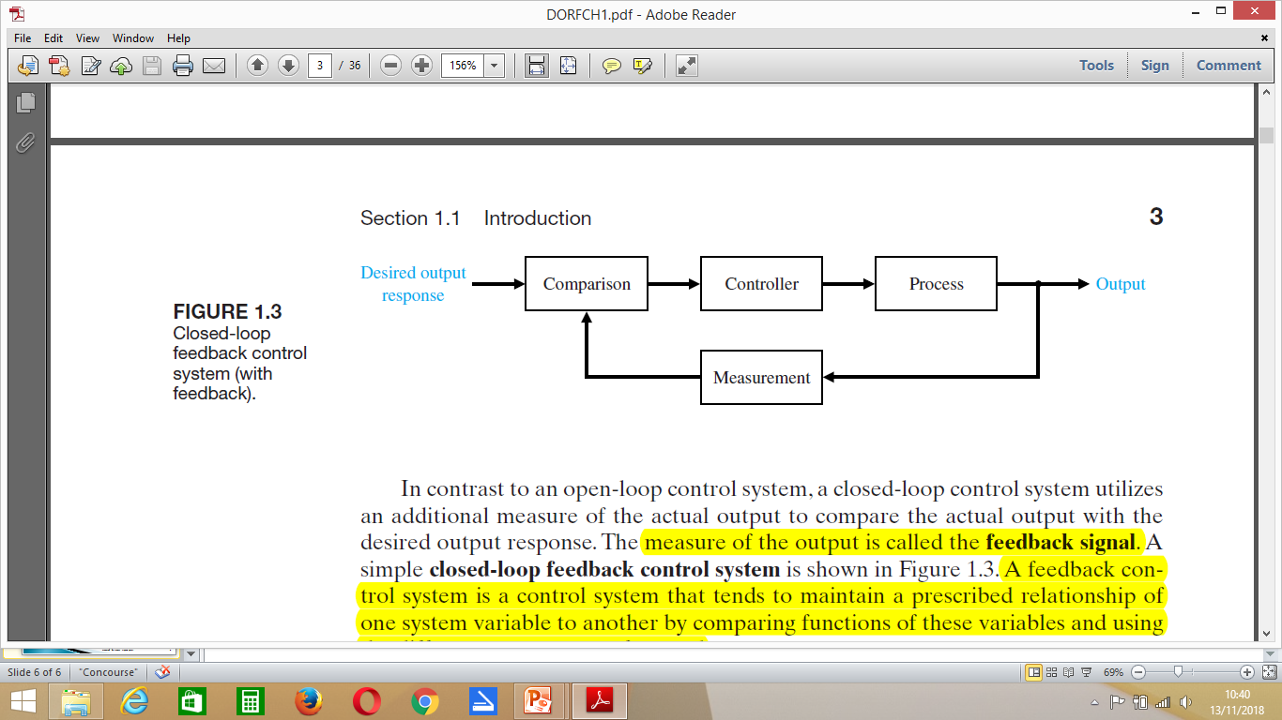
Cont..
Fig. 1.3: Closed –loop feedback control system
Therefore:
A closed – loop control system uses a measurement of the output and feedback of this signal to compare it with the desired output (reference or command)

Slide 10
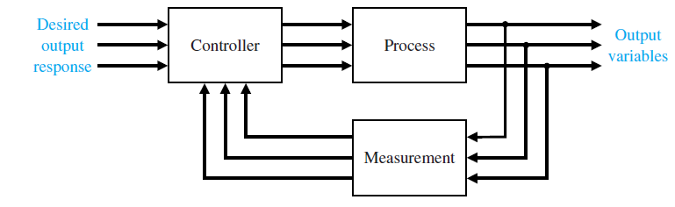
Cont..
Due to the increasing complexity of the system under control and the interest in achieving optimum performance, the importance of control system engineering has grown in the past decade. Furthermore, as the systems become more complex, the interrelationship of many controlled variables must be considered in the control scheme. A block diagram depicting a multivariable control system is shown in figure below

Slide 11
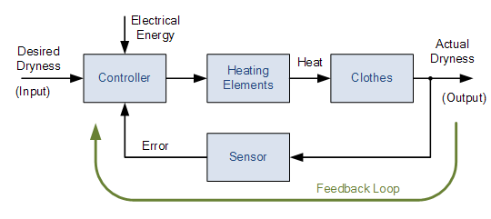
Cont..
Example of closed loop control system
Consider electric clothes dryer:
Suppose we used a sensor or transducer (input device) to continually monitor the temperature or dryness of the clothes and feed a signal relating to the dryness back to the controller as shown below

Slide 12
Cont..
This sensor monitors the actual dryness of the clothes and compare it with (or subtract it from) the input reference. The error signal (error = required dryness – actual dryness) is amplified by the controller, and the controller output makes the necessary correction to the heating system to reduce any error.
For example if the clothes are too wet the controller may increase the temperature or drying time. Likewise, if the clothes are nearly dry it may reduce the temperature or stop the process so as not to overheat or burn the clothes, etc.

Slide 13
Cont..
Advantages of closed-loop control system
Accuracy: They are more accurate than open loop system due to their complex construction. They are equally accurate and are not disturbed in the presence of non-linearities.
Noise reduction ability: Since they are composed of a feedback mechanism, so they clear out the errors between input and output signals, and hence remain unaffected to the external noise sources
To reduce errors by automatically adjusting the systems input.
To improve stability of an unstable system.
To increase or reduce the systems sensitivity.
To enhance robustness against external disturbances to the process.
To produce a reliable and repeatable performance

Slide 14
Cont..
Disadvantages;
Construction: They are relatively more complex in construction and hence it adds up to the cost making it costlier than open loop system.
Since it consists of feedback loop, it may create oscillatory response of the system
Stability: It is less stable than open loop system but this disadvantage can be striked off since we can make the sensitivity of the system very small so as to make the system as stable as possible
The feedback reduces the overall gain of the system

Slide 15
The End

Slide 16
Control System Block Diagrams
Block Diagram Representation of Control Systems
A Block Diagram is a shorthand pictorial representation of the cause-and-effect relationship of a system.
The interior of the rectangle representing the block usually contains a description of or the name of the element, or the symbol for the mathematical operation to be performed on the input to yield the output.
The arrows represent the direction of information or signal flow.

Slide 17
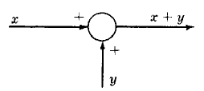
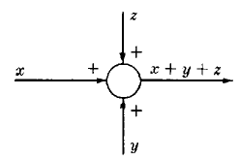
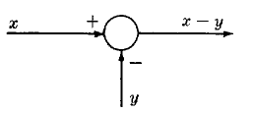
Cont..
The operations of addition and subtraction have a special representation.
The block becomes a small circle, called a summing point, with the appropriate plus or minus sign associated with the arrows entering the circle.
The output is the algebraic sum of the inputs.
Any number of inputs may enter a summing point.
Some books put a cross in the circle.

Slide 18
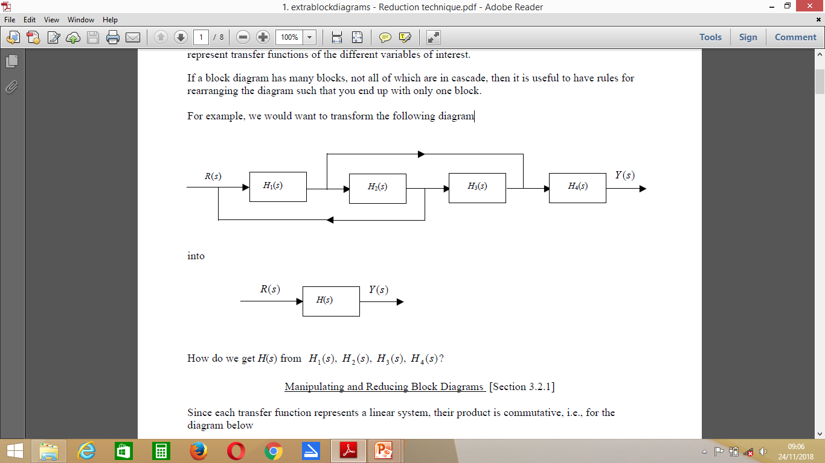
Cont..
Now
If a block diagram has many blocks, not all of which are in cascade, then it is useful to have rules for rearranging the diagram such that you end up with only one block.
For example, we would want to transform the following diagram

Slide 19
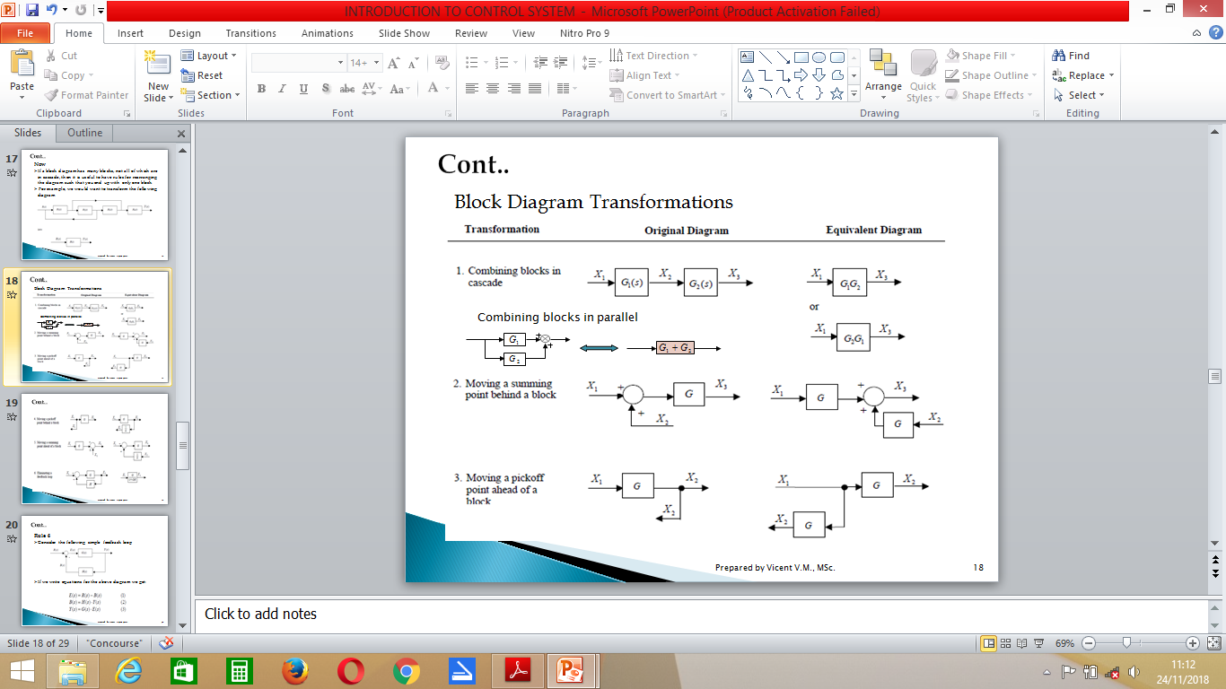
Cont..
Block Diagram Transformations

Slide 20
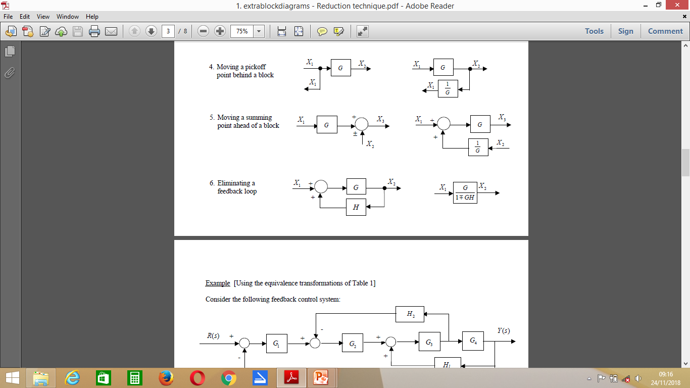
Cont..

Slide 21
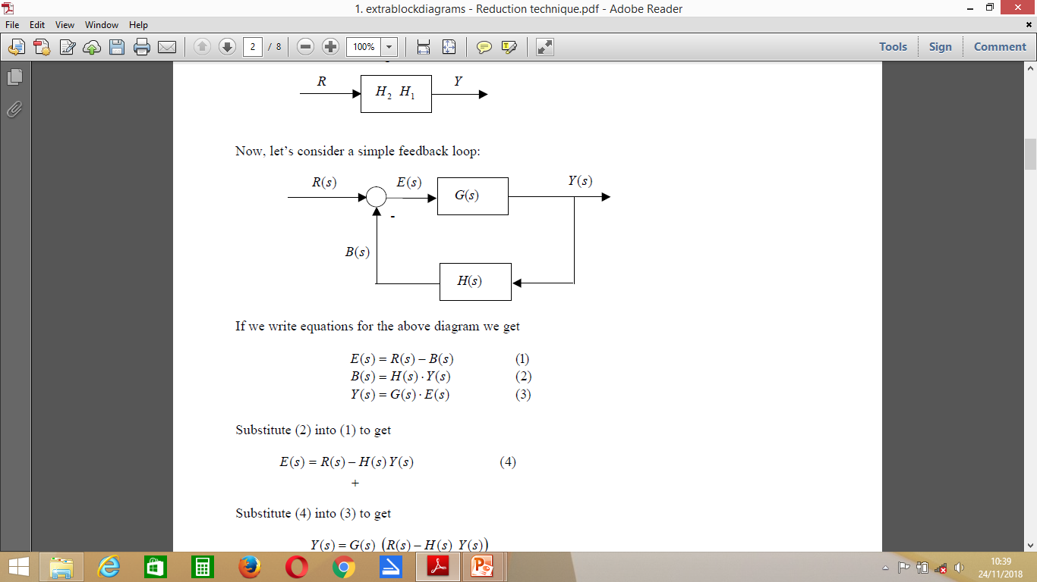
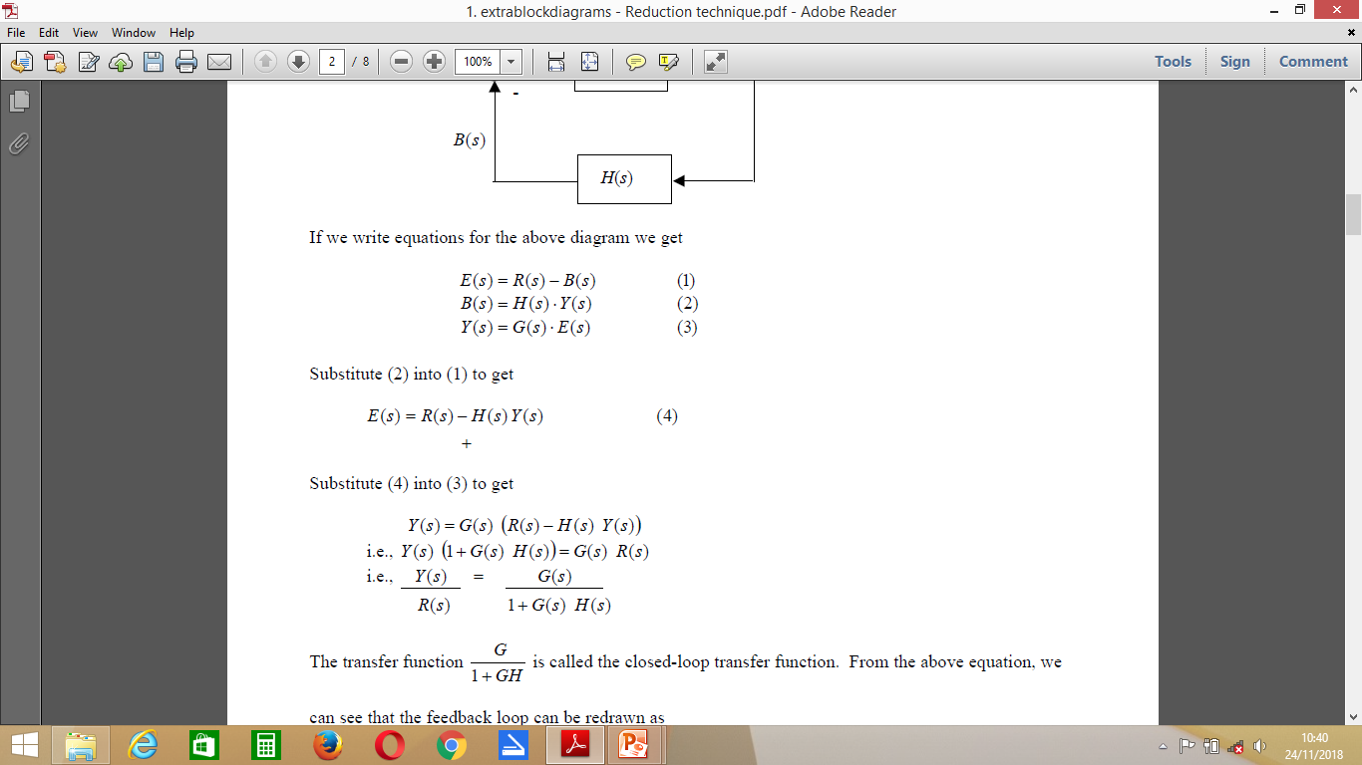
Cont..
Rule 6
Consider the following simple feedback loop
If we write equations for the above diagram we get:

Slide 22
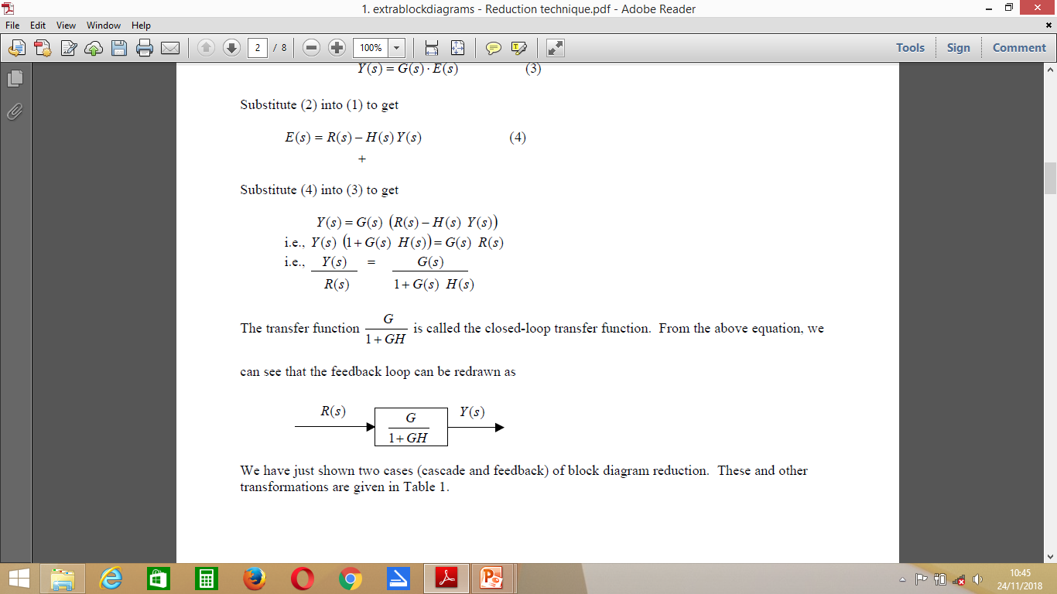

Cont..
Substitute (2) into (1) to get
Substitute (4) into (3) to get

Slide 23
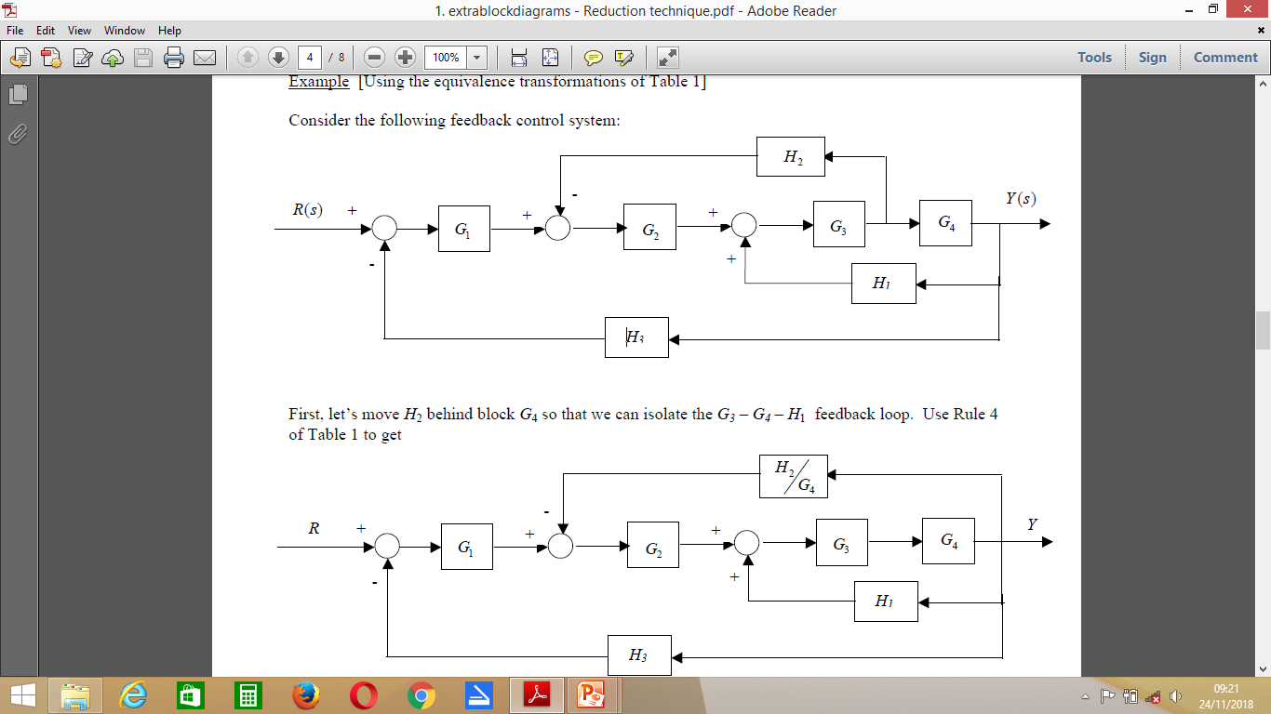
Cont..
Example 1
Consider the following feedback control system:

Slide 24
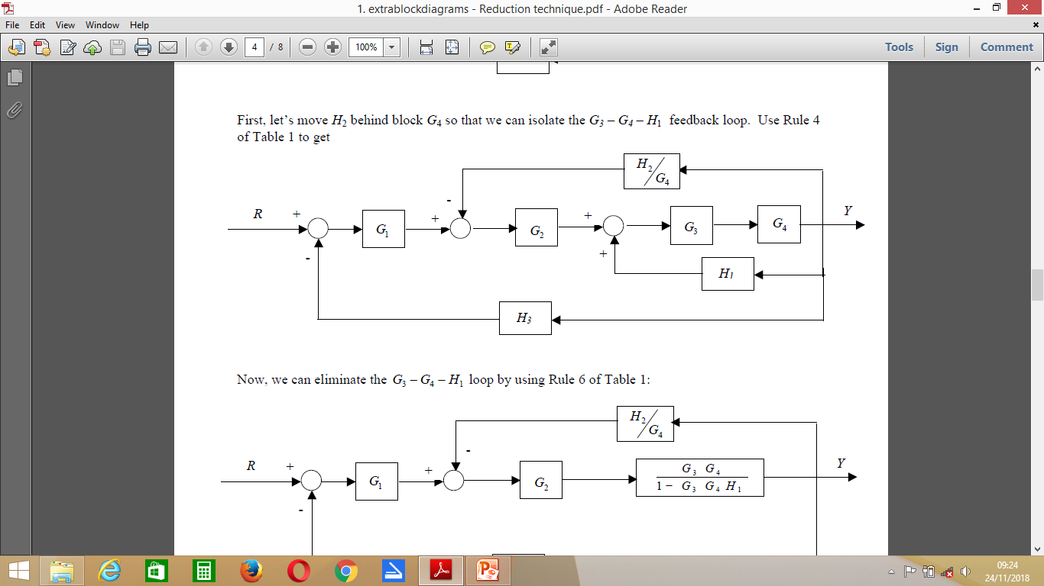
Cont..
First, let’s move H2 behind block G4 so that we can isolate the G3 – G4 – H1 feedback loop. Use Rule 4 of Table 1 to get

Slide 25
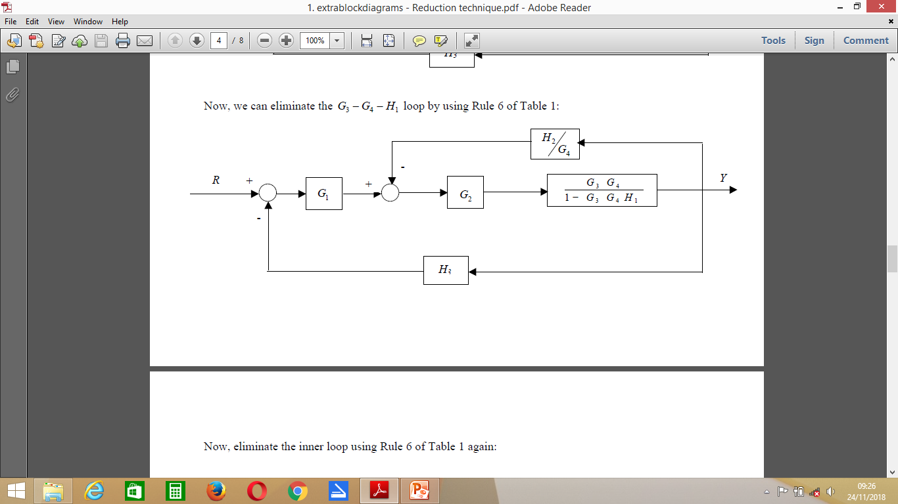
Cont..
Now, we can eliminate the 3 4 1 G -G - H loop by using Rule 6 of Table 1:

Slide 26
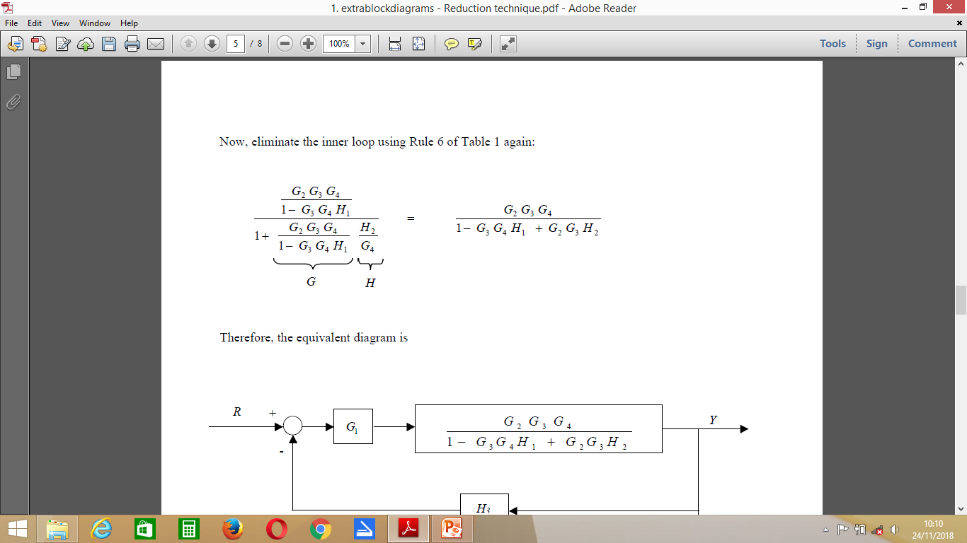
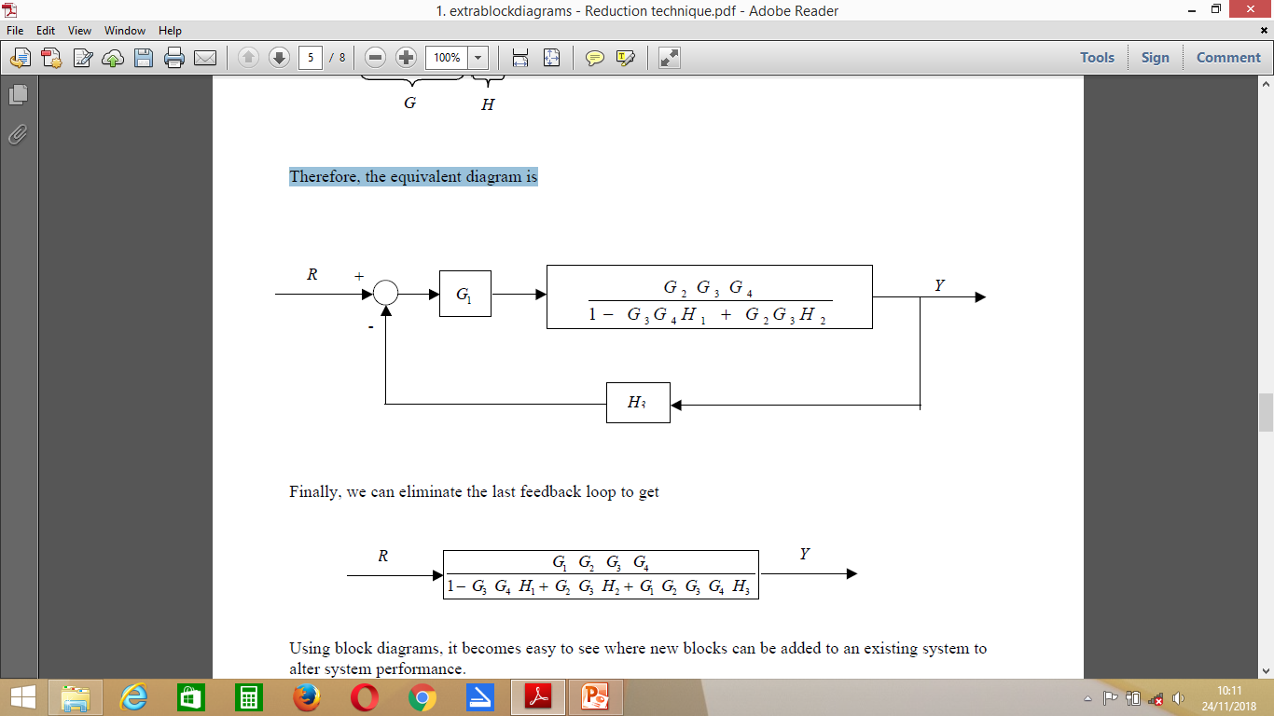
Cont..
Now eliminate inner loop using Rule 6
Therefore, the equivalent diagram is

Slide 27
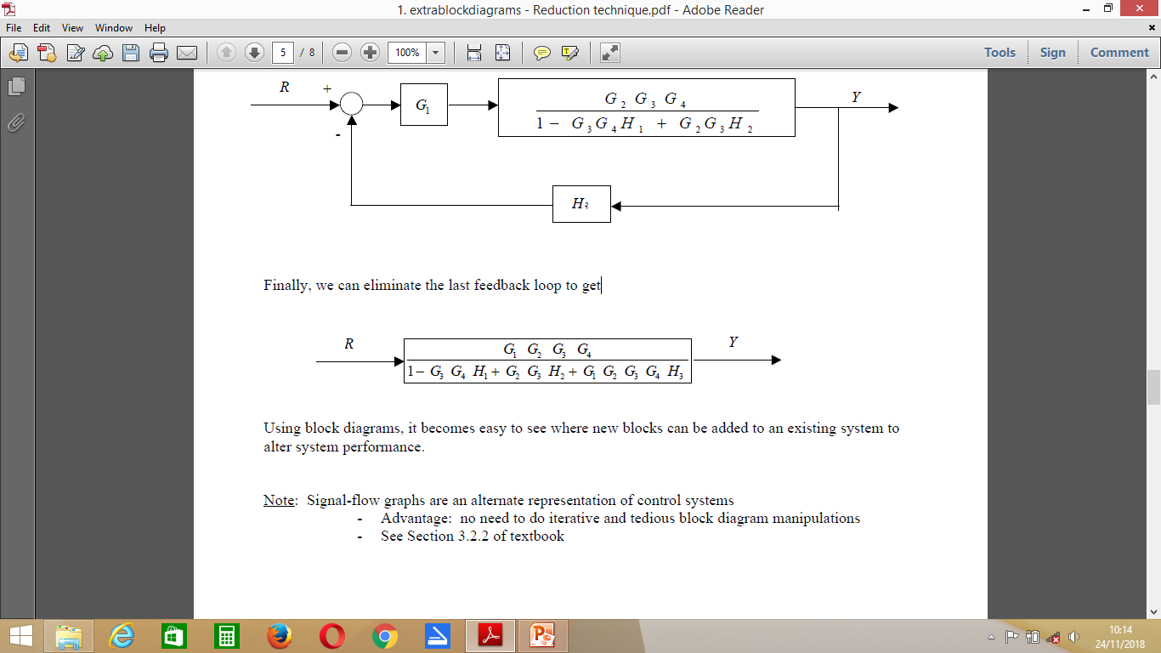
Cont..
Finally, we can eliminate the last feedback loop to get:
Using block diagrams, it becomes easy to see where new blocks can be added to an existing system to alter system performance.

Slide 28
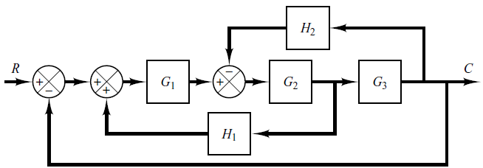
Cont..
Example 2:
Reduce the following multi system into a single block diagram

Slide 29
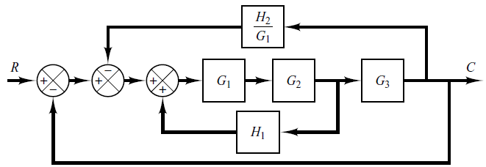
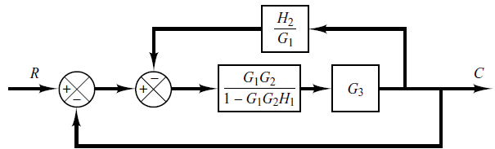
Cont..
By moving the summing point of the negative feedback loop containing H2 outside the positive loop containing H1, we obtain:
Eliminate the positive feedback loop, we get:

Slide 30
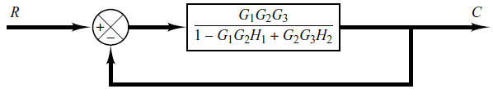
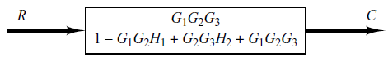
Cont..
The elimination of the loop containing H2/G1 gives:
Finally, eliminating the feedback loop gives:

Slide 31
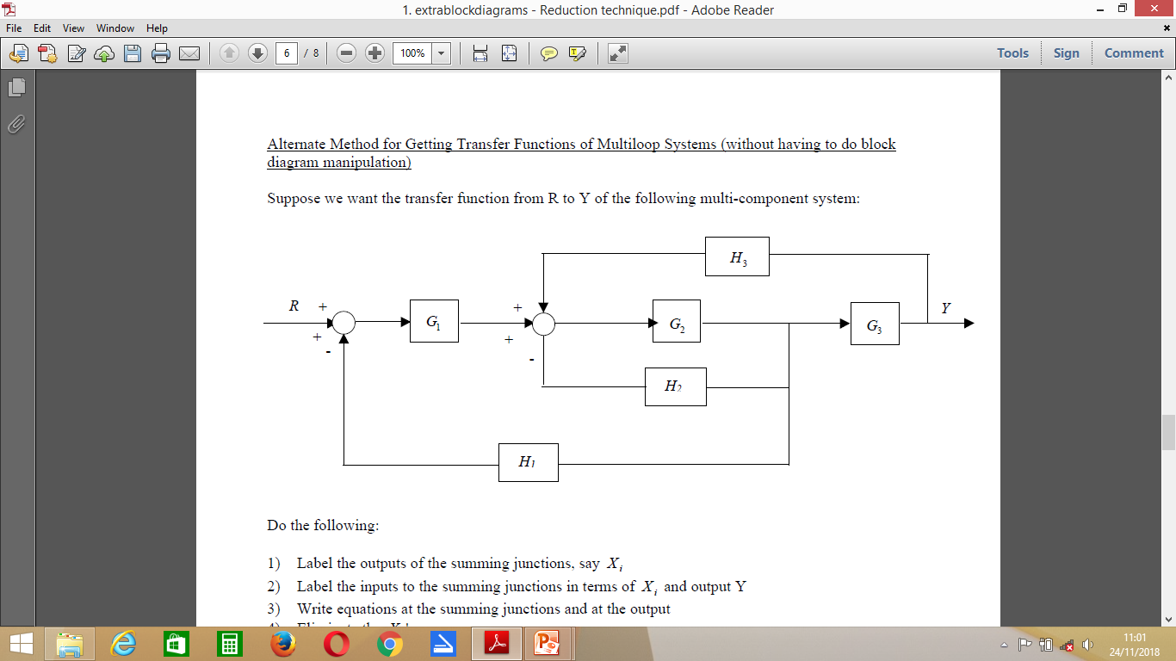
Home Work
Q1
Reduce the following multi system into a single block diagram

Slide 32
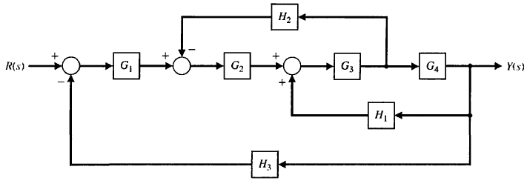
Cont..
Q2
Simplify the following block diagram into a single block

Slide 33
The End

Slide 34
Signal Flow Graphs
For complex control systems, the block diagram reduction technique is cumbersome.
An alternative method for determining the relationship between system variables has been developed by Mason and is based on a signal flow graph.
A signal flow graph is a diagram that consists of nodes that are connected by branches. A node is assigned to each variable of interest in the system, and branches are used to relate the different variables.
The main advantage for using SFG is that a straight forward procedure is available for finding the transfer function in which it is not necessary to move pickoff point around or to redraw the system several times as with block diagram manipulations.

Slide 35
Cont..
In other words
Signal flow graphs are a pictorial representation of the simultaneous equations describing a system.
Signal flow graphs display the transmission of signals through the system, as does the block diagrams, but it is easier to draw and easier to manipulate than the block diagrams.
Unlike block diagrams, which consist of blocks, signals, summing junctions, and pickoff points, a signal-flow graph consists only of branches, which represent systems, and nodes, which represent signals.

Slide 36
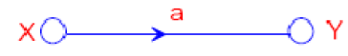
Cont..
SFG is a diagram that represents a set of simultaneous linear algebraic equations which describe a system. Let us consider an equation, y = ax. It may be represented graphically as;
Terminologies:
Node: A junction denoting a variable or a signal.
Branch: A unidirectional path that relates the dependency of an input and an output.
Relation between variables is written next to the directional arrow.
Path: A branch or a continuous sequence of branches that can be traversed from one node to another

Slide 37
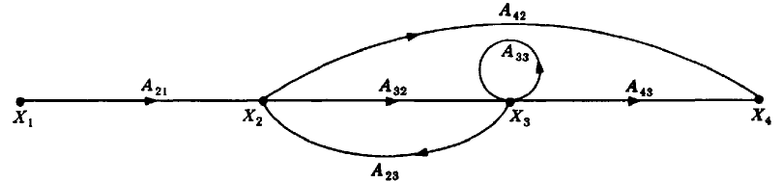
Cont..
An input node or source contain only the outgoing branches. i.e., X₁
An output node or sink contain only the incoming branches. i.e., X4
A path is a continuous, unidirectional succession of branches along which no node is passed more than ones. i.e., X1 to X2 to X3 to X4, X2 to X3 back to X2, X1 to X2 to X4, are paths.
A forward path is a path from the input node to the output node. i.e., X1 to X2 to X3 to X4, and X1 to X2 to X4, are forward paths.

Slide 38
Cont..
A feedback path or feedback loop is a path which originates and terminates on the same node. i.e.; X2 to X3 and back to X2 is a feedback path.
A self-loop is a feedback loop consisting of a single branch. i.e.; A₃₃ is a self loop.
The gain of a branch is the transmission function of that branch when the transmission function is a multiplicative operator. i.e., A33
The path gain is the product of branch gains encountered in traversing a path. i.e., X1 to X2 to X3 to X4 is A₂₁A₃₂A₄₃
The loop gain is the product of the branch gains of the loop. i.e., the loop gain of the feedback loop from X2 to X3 and back to X2 is A₃₂A_{23.}

Slide 39
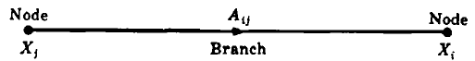
Cont..
Consider a simple equation below and draw its signal flow graph:
X_{i} = A_{ij}X_{j}
The signal flow graph of the equation is shown below;
Every variable in a signal flow graph is designed by a Node.
Every transmission function in a signal flow graph is designed by a Branch.
Branches are always unidirectional.
The arrow in the branch denotes the direction of the signal flow.
The variables X_{i} and X_{j} are represented by a small dot or circle called a Node.
The transmission function A_{ij} is represented by a line with an arrow called a Branch.

Slide 40
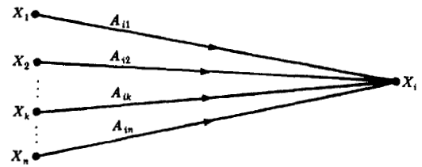
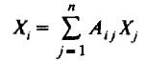
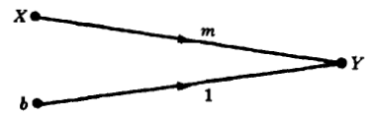
Cont..
1. The Addition Rule:
The value of the variable designated by a node is equal to the sum of all signals entering the node. This can be represented as;
Example: The signal flow graph for the equation of a line in rectangular coordinates, Y = mX + b, is given below. Since b is a constant it may represent a node or a transmission function

Slide 41
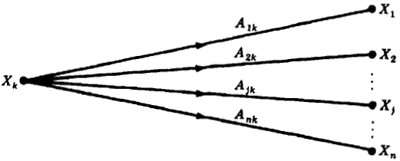
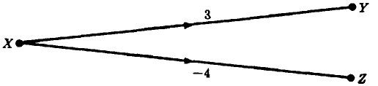
Cont..
2. The Transmission Rule:
The value of the variable designed by a node is transmitted on every branch leaving that node.
Example: The signal flow graph of the simultaneous equations, Y = 3X, and, Z = -4X, is given in the figure below.

Slide 42
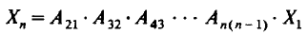
Cont..
3. The Multiplication Rule:
A cascaded or series connection of n-1 branches with transmission functions , can be replaced by a single branch with a new transmission function equal to the product of the old ones. That is
Example: The signal flow graph of the simultaneous equations Y = 10X, Z = -20Y, is given in

Slide 43
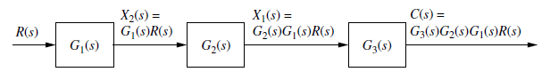
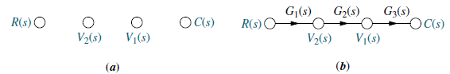
Cont..
Converting Cascaded Block Diagram into a Signal Flow Graph
First thing is to draw the signal nodes for the system.
Next thing is to interconnect the signal nodes with system branches.
The signal nodes for the system are shown in figure (a).
The interconnection of the nodes with branches that represent the subsystem is shown in figure (b).

Slide 44
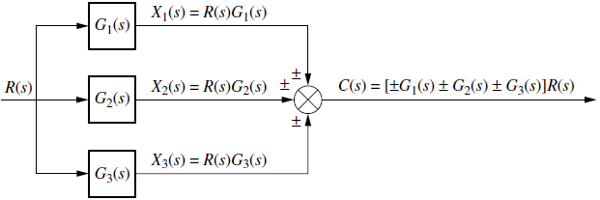
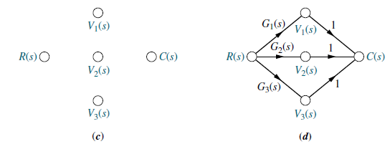
Cont..
Converting Parallel System Block Diagram into a Signal Flow Graph:
First thing is to draw the signal nodes for the system.
Next thing is to interconnect the signal nodes with system branches.
The signal nodes for the system are shown in figure (c).
The interconnection of the nodes with branches that represent the subsystem is shown in figure (d).

Slide 45
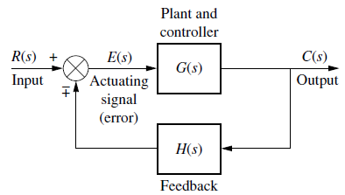
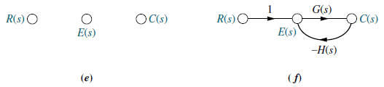
Cont..
Converting Feedback System Block Diagram into a Signal Flow Graph:
First thing is to draw the signal nodes for the system.
Next thing is to interconnect the signal nodes with system branches.
The signal nodes for the system are shown in figure (e).
The interconnection of the nodes with branches that represent the subsystem is shown in figure (f).

Slide 46
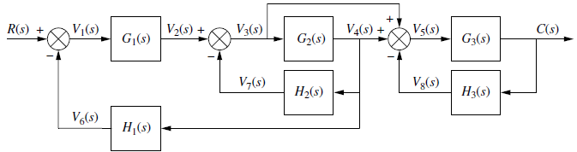
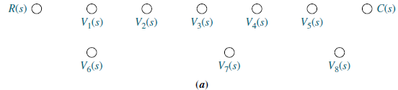
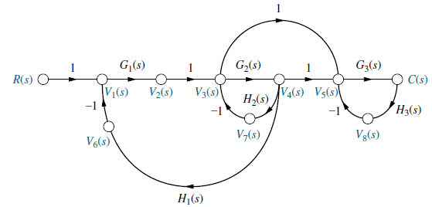
Cont..
Example 1:
Convert the block diagram into a signal flow graph

Slide 47
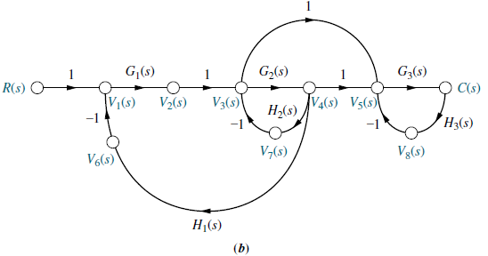
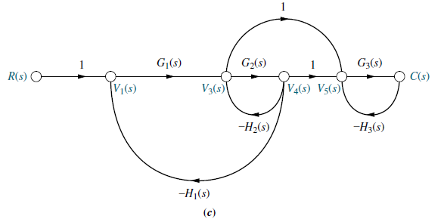
Cont..
If desired, simplify the signal-flow graph to the one shown in Figure (c) by eliminating signals that have a single flow in and a single flow out, such as V2(s), V6(s), V7(s), and V8(s).

Slide 48
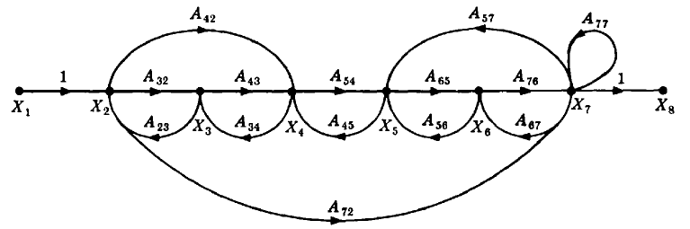
Cont..
Example 2:
Consider the signal flow graph below and identify the following
Input node.
Output node.
Forward paths.
Feedback paths.
Self loop.
Determine the loop gains of the feedback loops.
Determine the path gains of the forward paths.

Slide 49
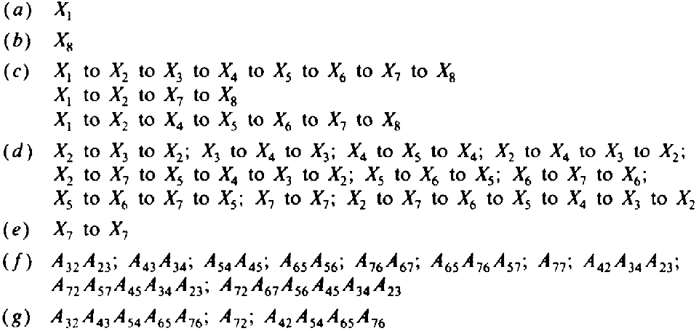
Cont..
Soln.

Slide 50
Mason’s Rule (Mason, 1953)
The block diagram reduction technique requires successive application of fundamental relationships in order to arrive at the system transfer function.
On the other hand, Mason’s rule for reducing a signal-flow graph to a single transfer function requires the application of one formula.
The formula was derived by S. J. Mason when he related the signal-flow graph to the simultaneous equations that can be written from the graph.

Slide 51
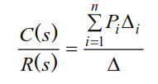
Cont..
Mason’s Rule:
The transfer function, T = C(s)/R(s), of a system represented by a signal-flow graph is;
Where
n = number of forward paths.
P_{i} = the i th forward-path gain.
∆ = 1 - ∑P_{j1} + ∑P_{j2} - ∑P_{j3} +…..
= 1 - ∑ loop gains + ∑ gain products of two non-touching loops - ∑ gain products of three non-touching loops + . . .
∆_{i} = ∆ - ∑ loop gain terms in ∆ that touch the i th forward path: In other words;
∆_{i} is formed by eliminating from ∆ those loop gains that touch the i th forward path.
Notes:
P_{jk} = j th possible product of k nontouching loop gains.

Slide 52
Cont..
Two loops, paths, or loop and a path are said to be non-touching if they have no nodes in common.
∆ is called the signal flow graph determinant or characteristic function. Since ∆=0 is the system characteristic equation.

Slide 53
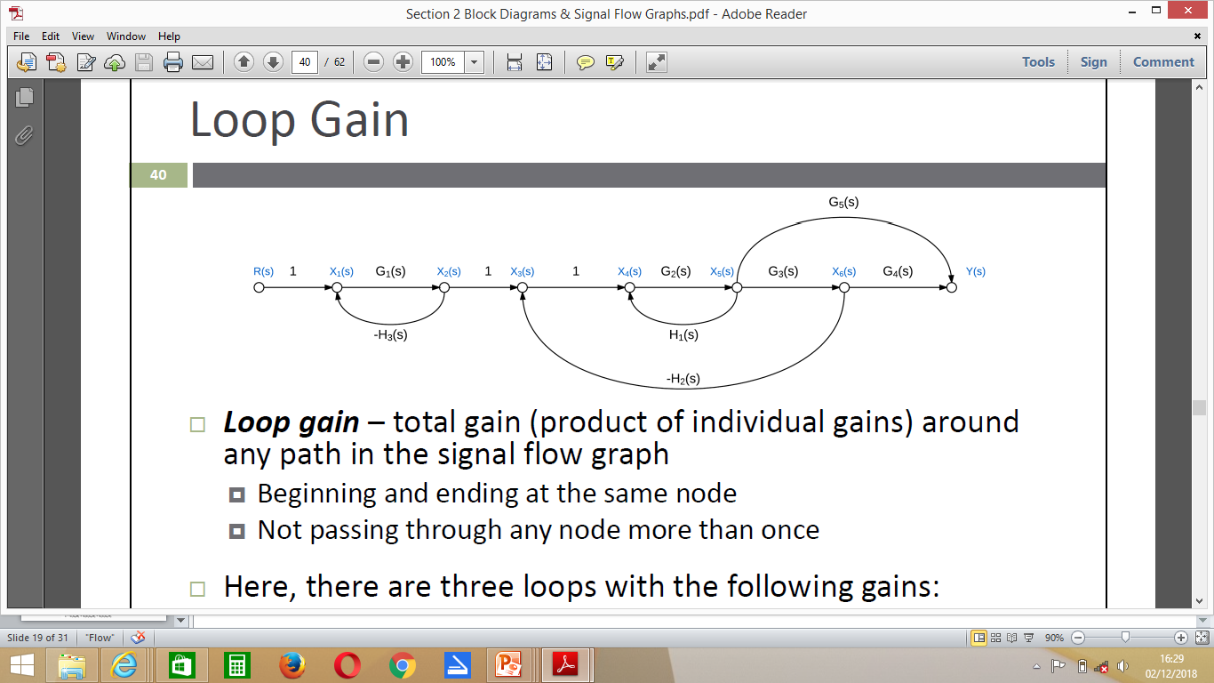
Cont..
Loop gains
Loop gain – total gain (product of individual gains) around
any path in the signal flow graph
Beginning and ending at the same node
Not passing through any node more than once

Slide 54


Cont..
Here, there are three loops with the following gains:
Forward path gain – gain along any path from the input to the output
Not passing through any node more than once
Here, there are two forward paths with the following gains:

Slide 55


Cont..
Non‐touching loops – loops that do not have any nodes in common
Here:
Non‐touching loop gains – the product of loop gains from non‐touching loops, taken two, three, four, or more at a time
Here, there are only two pairs of non‐touching loops

Slide 56

Cont..
Alternatively

Slide 57

Cont..

Slide 58

Cont..

Slide 59

Cont..

Slide 60

Cont..

Slide 61

Cont..
Example 2

Slide 62

Cont..

Slide 63

Home Work
Q1.
Determine the control ratio C/R and the canonical block diagram of the feedback control system

Slide 64
Cont..
Q2.
Apply Mason’s rule to determine the value of C(s)/R(s)
G9
-H₂
G₁
G₂
G₃
G₄
G₅
G₆
G₇
G₈
R(s)
C(s)
-H₄
-H₁
-H₅
-H₃

Slide 65
The End

Slide 66
Mathematical Modelling of Control System
In studying control systems one must be able to model dynamic systems in mathematical terms and analyze their dynamic characteristics.
A mathematical model of a dynamic system is defined as a set of equations that represents the dynamics of the system accurately, or at least fairly well. Note that, a mathematical model is not unique to a given system. A system may be represented in many different ways and, therefore, may have many mathematical models, depending on one’s perspective.
The dynamics of many systems, whether they are mechanical, electrical, thermal, economic, biological, and so on, may be described in terms of differential equations. Such differential equations may be obtained by using physical laws governing a particular system
Notes:
Differential equations: equation that relates functions and their derivatives
Functions – represent physical quantity while derivatives represent their rates of change

Slide 67
Cont..
In mathematics, a differential equation is an equation that relates one or more functions and their derivatives. In applications, the functions generally represent physical quantities, the derivatives represent their rates of change, and the differential equation defines a relationship between the two
In control system design the most common mathematical models of the behavior of interest are, in:
the time domain,
linear ordinary differential equations with constant coefficients, and in the
frequency or transform domain, transfer functions obtained from time domain descriptions via Laplace transforms.
The response of dynamic system to an input may be obtained if these differential equations are solved.

Slide 68
Cont..
For example; Newton’s laws for mechanical systems and Kirchhoff’s laws for electrical systems. We must always keep in mind that deriving reasonable mathematical models is the most important part of the entire analysis of control systems.
Model
A model is a simplified representation or abstraction of reality. Reality is generally too complex to model exactly.
Mathematical Model
A set of mathematical equations (e.g., differential eqs.) that describes the input-output behavior of a system.
It is used in:
Simulation
Prediction/Forecasting
Prognostics/Diagnostics
Design/Performance Evaluation
Control System Design

Slide 69
Cont..
Black Box Model
When only input and output are known.
Internal dynamics are either too complex or unknown.
Easy to Model
Input
Output
Grey Box Model
When input and output and some information about the internal dynamics of the system is known.
u(t)
y(t)
y[u(t), t]
Easier than white box Modelling.

Slide 70
Cont..
White Box Model
When input and output and internal dynamics of the system is known.
u(t)
y(t)
One should know complete knowledge of the system to derive a white box model.

Slide 71
Cont..
In control system engineering, one can derive mathematical models for
Electrical systems
Mechanical systems
Electromechanical system
Electronic circuits
It can be in:
Time domain/frequency domain
Laplace transformation
z- transformation
State space equation
It can be in:
Distributed / Lumped
Continuous / Discrete
Linear / Nonlinear
Time-variant / Time-invariant
Stochastic / Deterministic
Notes:
Stochastic – having a random probability distribution
Deterministic - philosophical

Slide 72
Cont..
Time Domain and Laplace Transformation
In time-domain analysis the response of a dynamic system to an input is expressed as a function of time.
It is possible to compute the time response of a system if the nature of input and the mathematical model of the system are known.
Usually, the input signals to control systems are not known fully ahead of time.
It is therefore difficult to express the actual input signals mathematically by simple equations.
The characteristics of actual input signals are a sudden shock, a sudden change, a constant velocity, and constant acceleration.

Slide 73
Cont..
The dynamic behavior of a system is therefore judged and compared under application of standard test signals – an impulse, a step, a constant velocity, and constant acceleration.
The other standard signal of great importance is a sinusoidal signal.
Time domain analysis examines the amplitude Vs time characteristic of measuring signal

Slide 74
Cont..
Frequency Domain Analysis
Frequency domain analysis replaces the measured signal with a group of sinusoidal which when added together, produces a waveform equivalent to the original signal. The relative amplitude, frequencies, and phases of the sinusoidal are examined
In time-domain analysis the response of a dynamic system to an input is expressed as a function of time c(t)
It is possible to compute the time response of a system if the nature of input and the mathematical model of the system are known

Slide 75
Cont..
The time response of a system can be obtained by solving the differential equation governing the system
Alternatively, the response c(t) can be obtained from the transfer function of the system and the input to the system
For closed loop transfer function,
Response in s-domain, (Laplace transformation)
C(s) = R(s)*M(s)
Response in t-domain, (time domain)
c(t)= inverse Lap[C(s)]

Slide 76
Cont..
Time Domain Specification
For specifying the desired performance characteristics of a measurement system
These characteristics of a system of any order may be specified in terms of transient response to a unit step input signal
The response of a second order system for a unit input is,
Peak overshoot
Settling time
Steady state error

Slide 77

Cont..

Slide 78
Cont..
Settling time: The time taken for a measuring or control instrument to get within a certain distance of a new equilibrium value without subsequently deviating from it by that amount
Rise time: The time required for a pulse to rise from 10 per cent to 90 per cent of its steady value
The delay time is the time required for the response to reach half the final value the very first time.
The peak time is the time required for the response to reach the first peak of the overshoot.
Steady state error: If the output of a control system at steady state does not exactly match with the input, the system is said to have steady state error

Slide 79
Cont..
Standard Test Signals
Impulse signal
The impulse signal imitate the sudden shock characteristic of actual input signal.
If A=1, the impulse signal is called unit impulse signal.
δ(t)
A
t
0

Slide 80
Cont..
Step signal
The step signal imitate the sudden change characteristic of actual input signal.
If A=1, the step signal is called unit step signal
u(t)
A
t
0

Slide 81
Cont..
Ramp signal
The ramp signal imitate the constant velocity characteristic of actual input signal.
If A=1, the ramp signal is called unit ramp signal
r(t)
t
0

Slide 82
Cont..
Parabolic signal
The parabolic signal imitate the constant acceleration characteristic of actual input signal.
If A=1, the parabolic signal is called unit parabolic signal.
p(t)
0
t

Slide 83
Cont..
Laplace Transform of Test Signals
Impulse
Step

Slide 84
Cont..
Ramp
Parabolic

Slide 85

Cont..
Relationship between standard Test Signals

Slide 86

Cont..
Laplace Transforms for Various Time-Domain Functions

Slide 87


Cont..
Time Response of Control Systems
Time response of a dynamic system response to an input expressed as a function of time.
The time response of any system has two components
Transient response
Steady-state response
System

Slide 88
Cont..
When the response of the system is changed from equilibrium, it takes some time to settle down. This is called transient response.
The response of the system after the transient response is called steady state response.

Slide 89
Cont..
Transient response depend upon the system poles only and not on the type of input.
It is therefore sufficient to analyze the transient response using a step input.
The steady-state response depends on system dynamics and the input quantity.
It is then examined using different test signals by final value theorem.

Slide 90

Cont..
Basic Elements of Electrical Systems

Slide 91

Cont..
Notes:
Capacitance – the ability of a system to store an electric charge

Slide 92

Cont..
Notes:
Inductance – the property of an electric conductor or circuit that causes an electromotive force to be generated by a change in the current flowing

Slide 93

Cont..
V-I and I-V relations

Slide 94

Cont..
Example 1
The two-port network shown in the following figure has v_{i}(t) as the input voltage and v_{o}(t) as the output voltage. Find the transfer function V_{o}(s)/V_{i}(s) of the network.
Solution
v_{i}( t)
i(t)
C
v_{o}(t)

Slide 95
Cont..
Taking Laplace transform of both equations, considering initial conditions to zero.
Re-arrange both equations as:
Substitute I(s) in equation on left

Slide 96
Cont..
Example 2
Write the state equation models for the RLC – circuit below:
Solution
The state equations of the network are obtained by writing the voltages across the inductors and the currents in the capacitor in terms of the three state variables as there are two inductors and one capacitor. The state equations are:

Slide 97




Cont..
$$e\left(t\right)=R_{1}i_{1}\left(t\right)+L_{1}\frac{{di}_{1}(t)}{dt}+e_{c}(t)$$
$e_{c}\left(t\right)=L_{2}\frac{{di}_{2}(t)}{dt}$+$R_{2}i_{2}$
$$C_{1}=e_{c}(t)$$
$$i_{1}=i_{c}+i_{2}$$

Slide 98
Cont..
In vector - matrix form

Slide 99


Home Work
Find the transfer functions of the RLC - circuit below i.e ,
$$\frac{i_{2}(t)}{e(t)}$$

Slide 100

Cont..
Mechanical System
Consider a simple mechanical system, a spring/mass/damper
It consists of a weight m on a spring with spring constant k, its motion damped by friction with coefficient f

Slide 101

Cont..
If y(t) is the displacement from the resting position and u(t) is the force applied, it can be shown using Newton’s law that the motion is described by the following linear, ordinary differential equation with constant coefficients:
Note that in the next subsection the trajectory y(t) is determined, in terms of the system parameters, the initial conditions, and the applied input force u(t), using a methodology based on Laplace transform

Slide 102
The End

